Slide 1
Blockchain
Blockchain Landscape
REVOLUTIONARY
POWERFUL
SIMPLE
FUTURE
Notes:
<number>

Slide 2

FOUNDER & LEAD BLOCKCHAIN DEV
Connor Howe
“We have elected to put our money and faith in a mathematical framework that is free of politics and human error.”
23 years old, born in Scotland, based in Cryptovalley Zug Switzerland. Graduated 2017 Business Computing with 1st class honours, and recipient of excellence in Computer Science award. Academically researched Ethereums Blockchain for dissertation, where I then turned down BT Cyber-Security graduate role to pursue my passion of Blockchain technology. Bitcoin user since 2012/2013.
MORE
Notes:
<number>

Slide 3
FOUNDED 01/08/18 - HOWETECHNOLOGYSOLUTIONS.IO
Howe Technology Solutions
We bring together veterans in front-end development, Smart Contract development, Marketing strategies and UI/UX all in one place. Together, we’re creating standout solutions for Blockchain - and we could do the same for you.
Token Economics
Smart Contract Development
Smart Contract Validation
If you are planning to create a utility or a security token, we can build the best model for your needs.
Whatever your project, we can build Smart Contracts from scratch - from start to finish.
We can validate Smart Contracts, implement industry-leading security and optimize gas usage.
Notes:
<number>

Slide 4
History Of Cryptocurrency
“The reason we’re all here is that the current financial system is outdated”
1
1997
Hashcash Proof of Work consensys proposed by Adam Back - limit email spam and DOS attacks.
1998
2
B-Money first proposal for an “anonymous, distributed electronic
cash system” - Wei Dai
3
1998
Bit-Gold electronic cash system proposed by Nick Szabo.
Notes:
<number>

Slide 5
2008
4
Bitcoin created and released by Satoshi Nakamoto. - “A Peer-To-Peer Electronic Cash System” .
5
2016
Ethereum created and released by multiple parties -
“A Next-Generation Smart Contract and Decentralized Application Platform”
6
TODAY
Over 2000+ cryptocurrencies that all have their own unique features.
Notes:
<number>

Slide 6
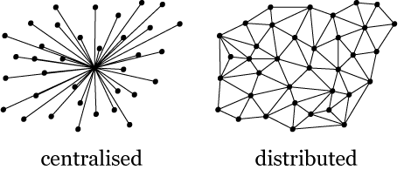
Centralized vs Distributed
“Trusted third parties are security holes.”
Centralized
Distributed
One party rules them all. All modifications, calculations, and anything else are done by one particular party.
No one party rules. All parties are equal, and agree upon any modifications, calculations, and anything else that writes to the Blockchain before it occurs.

Slide 7
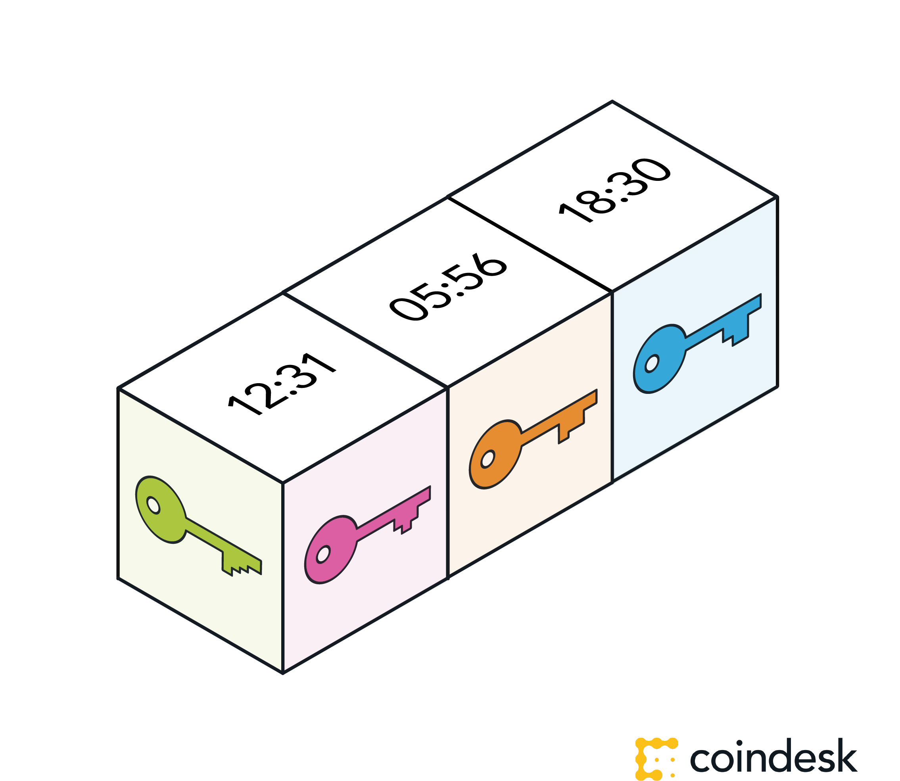

What is Blockchain?
“Blockchain is the tech. Bitcoin is merely the first mainstream manifestation of its potential.”
A BETTER TOMORROW
A Blockchain is a list of records, referred to as blocks, which are linked using cryptography. Each block contains a cryptographic hash of the previous block, a timestamp, and transactional data that occured.

Slide 8

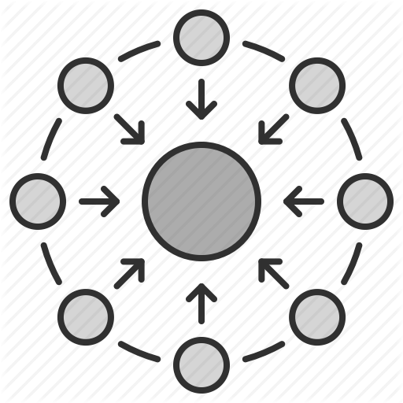


Blockchain Features
CONSENSUS
DISTRIBUTED
IMMUTABILITY
FINALITY
For a transaction to execute, multiple parties must agree to follow the same rules.
Not one party decides upon the rules of the network, and multiple can have copies of the same information.
No parity can modify a transaction once it has been recorded on the ledger.
One source of the truth - one ledger for the whole network.

Slide 9
Different accessibility feature definitions of Blockchain..
Permissionless vs Permissioned
“A single, universal Blockchain network cannot possibly serve all industries, granted the vastly different needs of businesses, and individual users.”
Permissionless - “Public”
Permissioned - “Private”
There is no barrier to entry to use it. Anyone can run a node, run mining software/hardware, access a wallet and write data onto and transact within the blockchain (as long as they follow the rules of the bitcoin blockchain). There is no way to censor anyone, ever, on the permissionless bitcoin blockchain.
Sometimes referred to as “private” blockchains, you are required to have some sort of permission to access any or parts of that blockchain. There are a multitude of variants and hybrid permissioned/permissionless blockchains that exist. For example a blockchain may be public to read the information but require permission to access or transact on their network.

Slide 10
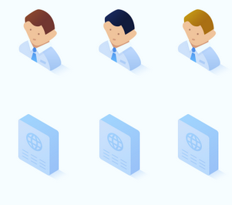
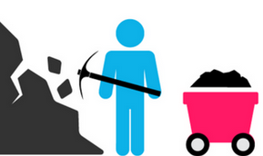
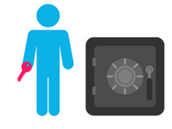
Consensus Algorithms
Consensus algorithms are used to confirm transactions, and produce new blocks to the Blockchain.
Proof of Work
Proof of Stake
Proof of Authority
With PoW, miners compete against each other to complete transactions on the network and get rewarded.
The main working principles is a mathematical puzzle to find the hash function - takes in input value, and from that input creates an output value deterministic of the input value.
With PoS, the creator of a new block is chosen in a deterministic way, depending on its wealth, also defined as stake.
No block reward is given, and miners are known as forger who take the transaction fee as the reward.
PoA consensus is essentially an optimized PoS model that leverages identity as the form of stake rather than actually staking tokens.
The identity is staked by a group of validators (authorities) that are pre-approved to validate transactions and blocks within the respective network.
Bitcoin + Ethereum
Dash
VeChainThor
Notes:
<number>

Slide 11
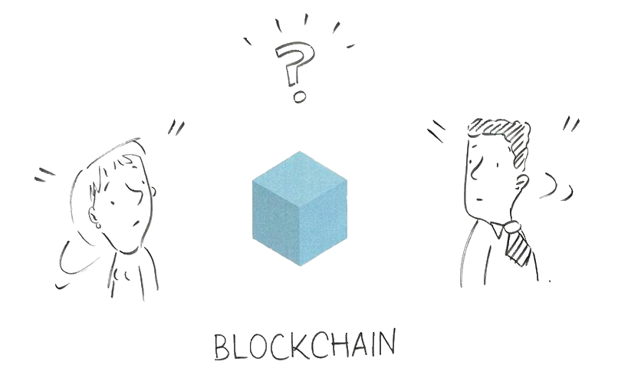
A single, universal Blockchain network cannot possibly serve all industries, granted the vastly different needs of businesses, and individual users
Notes:
<number>

Slide 12

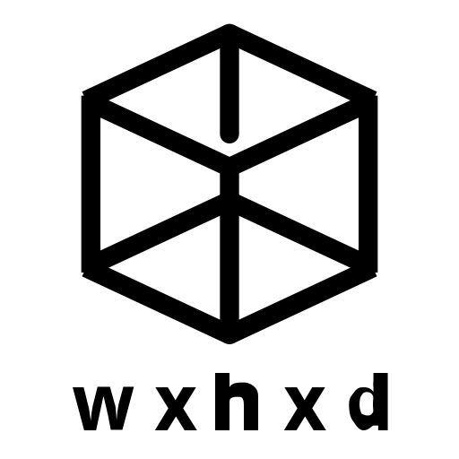



Factors For Deciding Blockchain
Every project has different requirements, don’t jump into developing on one Blockchain before deciding these factors.
TPS
Permission
Privacy
Use Case
How fast you need to execute.
Permissionless/
Permissioned.
Transactional state.
What will your project do.
Block Size
Block Time
Cost
Consensus
How much data you need to store.
How fast do you need your transaction to be included in a block.
How much are you willing to spend.
Mining hashing algorithm used to validate transactions.

Slide 13
Bitcoin
A Peer-To-Peer Electronic Cash System.
TPS
Permission
Privacy
Use Case
7.
Permissionless.
No private transactions, all public.
Storage/transfers of funds.
Block Size
Block Time
Cost
Consensus
1mb.
10-12 mins.
0.5$
Proof of Work
bit.ly/2D0CVsZ

Slide 14
Ethereum
A Next-Generation Smart Contract and Decentralized Application Platform.
TPS
Permission
Privacy
Use Case
26
Permissionless.
ZKSnarks, you can hide some data.
Fully decentralized application that can run - turing complete.
Block Size
Block Time
Cost
Consensus
None - gas limit is 7,999,992, each transaction is 21k gas
10-17 seconds.
0.013$
PoW > wants to change to PoS.
bit.ly/2PhSWQT

Slide 15
Stellar
The Stellar Consensus Protocol: A Federated Model for Internet-Level Consensus
TPS
Permission
Privacy
Use Case
1,000
Permissionless.
None, fully public.
Fast monetary transfers/anchors.
Block Size
Block Time
Cost
Consensus
N/A
3-5 seconds
<0.00001$
Ripple consensus algorithm.
bit.ly/2AoYTDi

Slide 16
Parity Substrate
Parity Substrate utilizes Polkadot, a heteregoneous mult-chain technology.
TPS
Permission
Privacy
Use Case
Block Size
Block Reward
Cost
Consensus

Slide 17

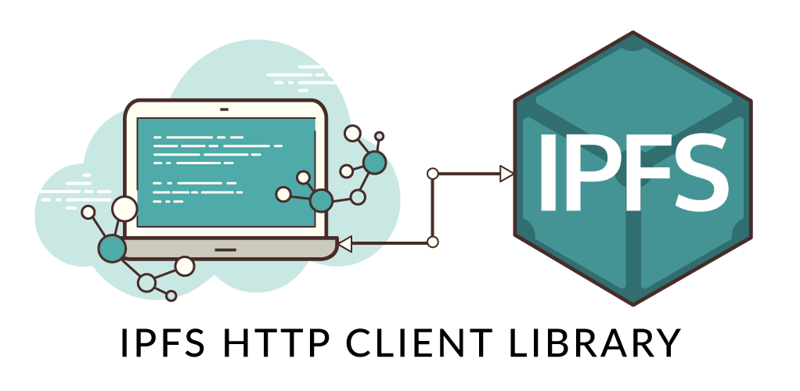
IPFS began as an effort by Juan Benet to build a system that is very fast at moving around versioned scientific data. Versioning gives you the ability to track how states of software change over time (think Git). IPFS has since become thought of as the The Distributed, Permanent Web ; “IPFS is a distributed file system that seeks to connect all computing devices with the same system of files. In some ways, this is similar to the original aims of the Web, but IPFS is actually more similar to a single bittorrent swarm exchanging git objects. IPFS could become a new major subsystem of the internet. If built right, it could complement or replace HTTP. It could complement or replace even more. It sounds crazy. It is crazy.”
Inter Planatory File System.
IPFS
Peer-To-Peer file storage system.
Notes:
To change the image behind the Mock up.
Select the layer - > Right Click -> Send to Back -> Delete the image -> Drag & Drop your Own Picture -> Send to Back (again)
<number>

Slide 18


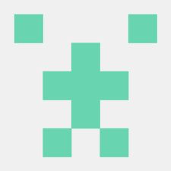


Tools for Smart Contract Dev
Ganache-Cli
Truffle
Solidity-Coverage
Remix
Localised chain of Ethereum.
Solidity development environment & test suite.
Shows test coverage of Truffle tests on Solidity files.
Online deployer to testnet/realnet for Smart Contracts.
MetaMask
Interacting with Smart Contracts on testnet/realnet.
Notes:
<number>

Slide 19
CONTACT ME
LinkedIn: Linkedin/in/ConnorHowe
Keybase: ConnorBlockchain
GitHub: ConnorBlockchain
Email: ConnorBlockchain@protonmail.com
GET IN TOUCH
Notes:
<number>

